Slide 1

Level: Advanced – session 5
Game Development with Unity
Omid Saadat

Slide 2
3D Pipeline
What is Vertex/Edge/Triangle => Mesh?
What is Texture?
  Diffuse, Normal, Spec, Gloss, Transparency, etc.
What is UV?
What is Material?
What is Shader?

Slide 3
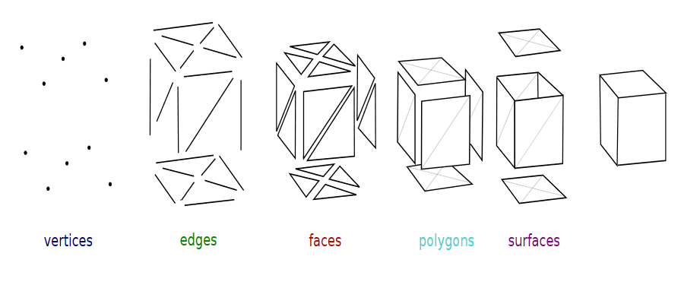
Mesh
Vertex: A single position in 3d world space (x,y,z)
Edge: A line between two vertex
Triangle: there is only one triangle between 3 points
Connect some triangles together to have a 3D MESH!

Slide 4
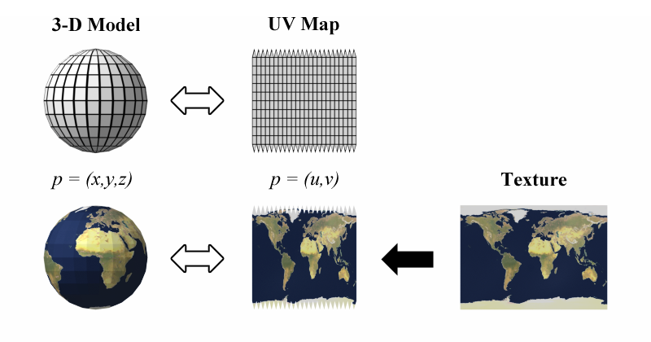
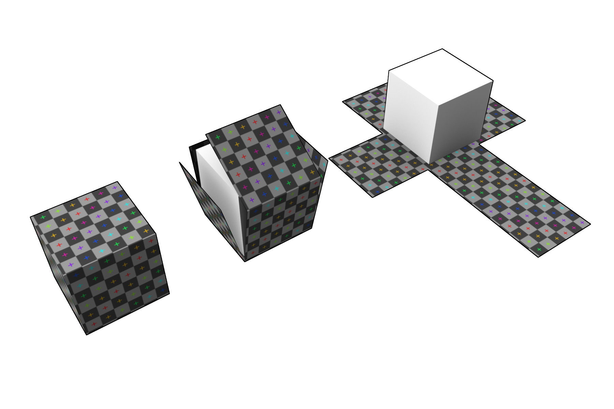
UV mapping
the 3D modeling process of projecting a 2D image to a 3D model's surface for texture mapping.

Slide 5
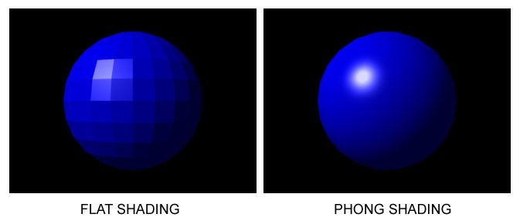
Shader
Wikipedia says:
  a shader is a computer program that is used to do shading: the production of appropriate levels of light, darkness, and color within an image, or, in the modern era, also to produce special effects or do video post-processing.

Slide 6
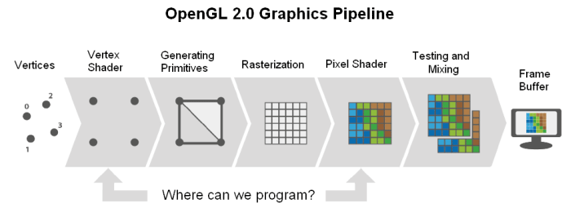
Shaders

Slide 7
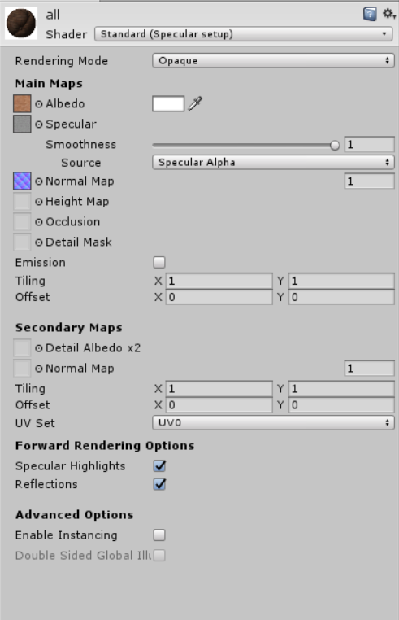
Material
Customize your shader in an easy way
Use one shader on multiple meshes
Edit the values at runtime

Slide 8
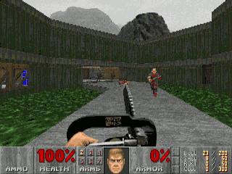
Textures
Diffuse map – or who cares about the lighting?

Slide 9
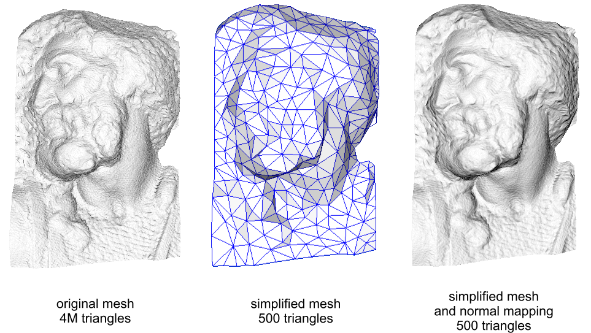
Textures
Normal map – or I do care about lighting!

Slide 10
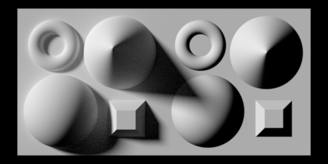
Textures
More about normal mapping:

Slide 11
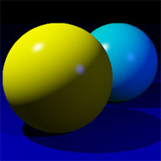
Textures
Specular map – or give me more lighting

Slide 12
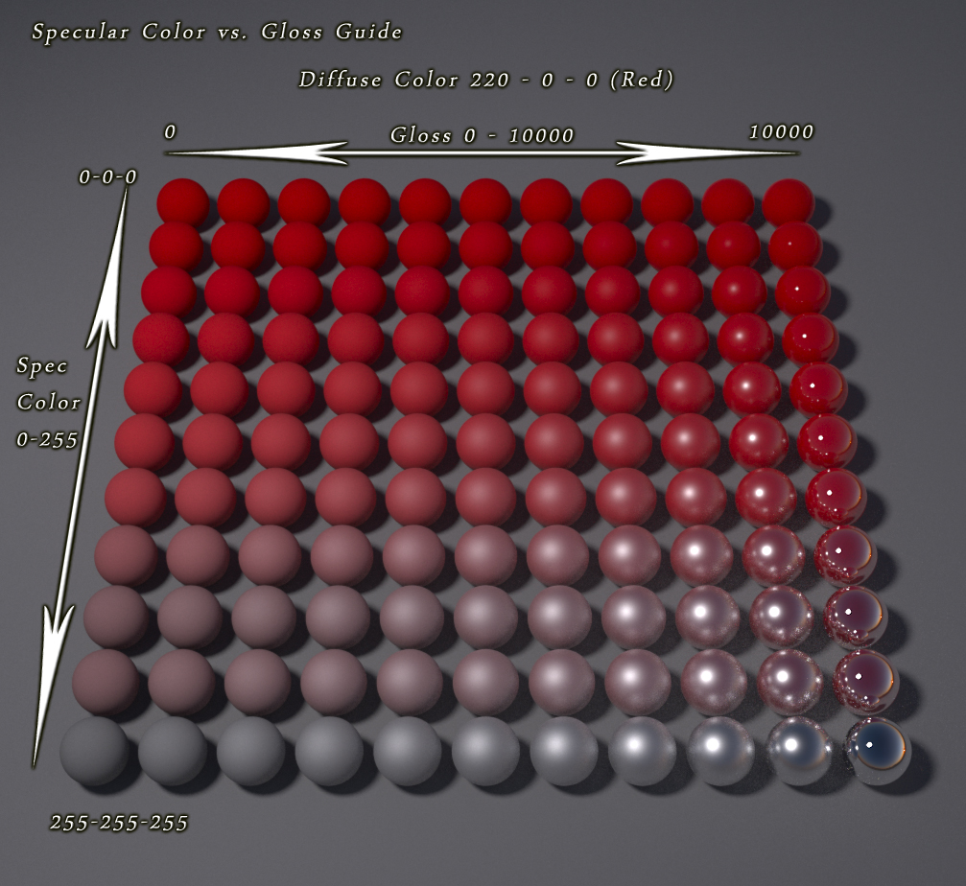
Textures
Glossiness map - or how should I spread the specularity?

Slide 13
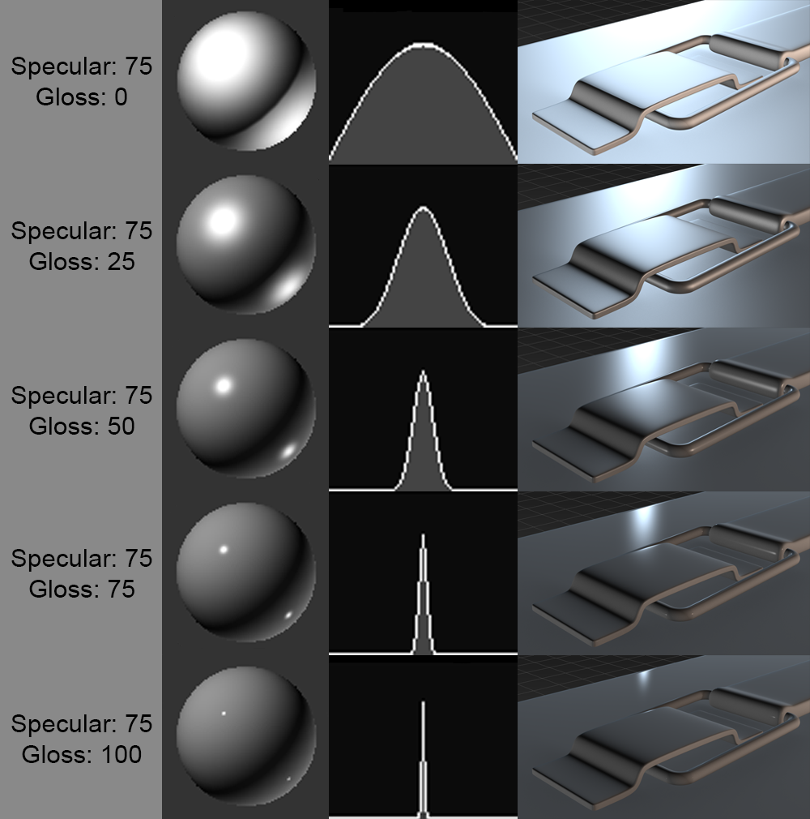
Textures
More sample on gloss map:

